Slide 1


2024-2025 Training Needs Assessment

Slide 2


Overview
Respondents- 17
Questions- 8
Objective- collect member agency training needs.
Did you receive the Survey? If not, contact us at Training@tc911.org.

Slide 3

The Biggest Need & Would Like to See Again
Additional Licensing Courses*
Leadership Courses
Mental Health Courses
Communications Training Officer
Spanish for Telecommunicators
CPR/T-CPR
Notes:
We will be discussing licensing on another slide Leadership one has been added in February, Strengthen Your Culture, Lessons for Leaders. Developing a New Supervisor Course. Due to be released in the Spring of 2025.
CTO and Spanish we usually 2x a year, will be added one additional class, possibly off-site.
CPR – We host often and the numbers of students will be increased to 10 at end of 2024 - 2025.

Slide 4

Additional Results
Team Building
Full Access
DPS Alerts
Suicidal Callers
Notes:
Team building: Workplace Wellness, Bullying, Interoffice Toxins, Culture, Breaking Bias
Full Access, we offer at least 4x a year – Will increase as we add more licensing classes.
DPS Course, increase to 2x a year based on results. One is scheduled for Feb 2025, will look to add one more.
Suicide Intervention was offered earlier this year and was cancelled due to lack of enrollment, is being offered again in December.

Slide 5


Licensing Courses
An additional licensing course was offered for in-district agencies only ( August).
Deadline for documents: one month before the start of class.
Opened up to outside agencies at the one-month deadline
7 Spots were still available as of July 1st.
Notes:
This class did not fill with in-district only, we had it posted on the calendar for at least 6 months. We do plan to do this again in 2025 to see how it fills after the needs assessment.
Licensing is typically offered 4x a year, but in 2025 we have 4 planned from January – July will add more in the Fall. January Licensing has 14 available spots, and we will be adding March’s class in September.

Slide 6
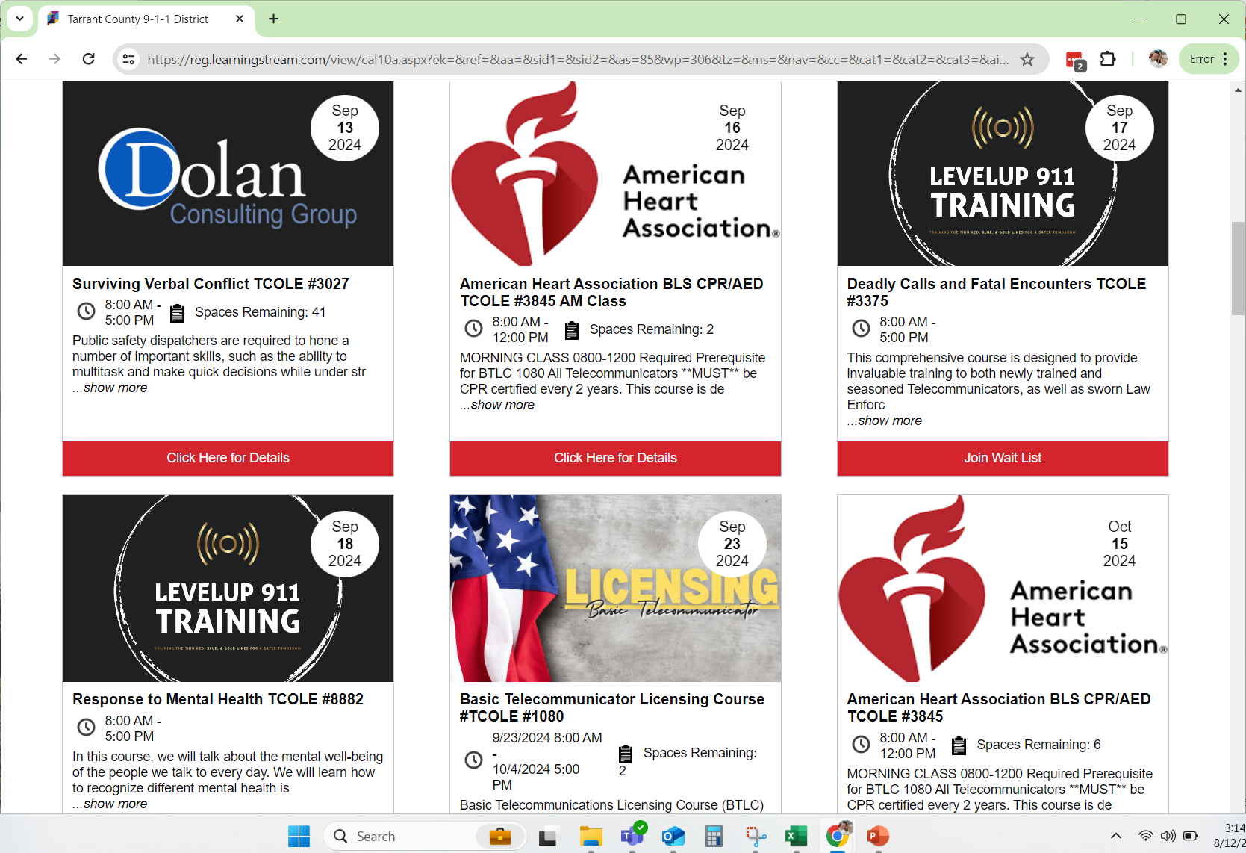
Training Updates
TC911.Org
Learning Stream (Course Catalog)
Flyers being sent out via Email
Make sure you are checking our catalog regularly – Classes fill up fast!
Notes:
Alberto Start

Slide 7

Curriculum In-Progress
High-Risk Incident Dispatching
Mental Health in 9-1-1
New Supervisor
Servant Leadership
Basics of Fire Dispatch

Slide 8


APCO 2024
Two Team Members attended the Conference
Attended over a dozen sessions
Networked
Plenty of new ideas brought back to our training curriculum
Notes:
2025 APCO Conference will be held in Baltimore, MD.

Slide 9

Upcoming Events
Texas Public Safety Fall Symposium – Bryan, TX , October 7-9, 2024
TCOLE Conference – McAllen, TX, October 28-30, 2024
Notes:
Additional Training Opportunities

Slide 10

Additional Feedback?
Any Questions, Comments, Concerns
Any other training ideas or requests for us?

